Slide 2
Integration of HIV/AIDS and Cervical Cancer Programs for Improved Health Outcomes in Tanzania Dr. January Zilabumba IMA World Health 30 November, 2015

Slide 3
Presentation Outline
Organizational Overview
Overview of Disease Burden
Overview of Projects
Approach
Results
Lessons Learnt
Recommendation

Slide 4
Organizational Overview
IMA World Health (IMA) is a nonprofit, international public health organization with faith-based roots
Mission: To build healthier communities by collaborating with key partners to serve vulnerable people.
Vision: Health, healing and well being for all!
20 years in Tanzania implementing health projects –NTDs, HIV/AIDS, MCH and NCDs (Cervical Cancer and Burkitt’s Lymphoma) including health systems strengthening components
Works in close collaboration with government, faith-based partners and communities

Slide 5
Magnitude of Cervical Cancer & HIV
Cervical cancer is the second most common cancer in women worldwide1; and ranks #1 of the top 10 cancers affecting women in Tanzania2. It accounts for :
40% of all Cancers at Ocean Road Institute of Cancer (ORCI)3
60% of all female reproductive cancers at ORCI4
HIV prevalence in Tanzania is 5.1% (prevalence higher among women 6.2%, than among men 3.8%).5
HIV infected women are 8 times more likely to develop invasive cervical cancer than women not infected.6
Notes:
http://www.who.int/mediacentre/factsheets/fs380/en/
http://www.biomedcentral.com/1471-2458/14/910
http://www.ncbi.nlm.nih.gov/pubmed/20204578
Ibid.
http://www.unaids.org/sites/default/files/country/documents/TZA_narrative_report_2014.pdf
http://www.ncbi.nlm.nih.gov/pubmed/26464500

Slide 6
Magnitude of Cervical Cancer & HIV
Nearly 99.7% of CACX are linked to infection with human papillomavirus (HPV)7
HIV+/ HPV infected women:8
have an increased risk of developing precancerous lesions
are likely to have a recurrence of precancerous lesions after treatment.
Have precancerous lesions that progress rapidly to cervical cancer .
have higher risk (5x or more) of developing cervical cancer than HIV(-) women
Notes:
7. http://www.who.int/mediacentre/factsheets/fs297/en/
8. http://www.researchgate.net/publication/224871963_Prevalence_and_Risk_Factors_Associated_with_Precancerous_Cervical_Cancer_Lesions_among_HIV-Infected_Women_in_Resource-Limited_Settings

Slide 7
Overview of Cervical Cancer Projects
Implemented since 2011 to date. Funded by CDC Tanzania and Private Donors
Supports MOH in the implementation of the Tanzania Cervical Cancer Prevention and Control Program (CECAP)
Designed to improve access to cervical cancer screening services.
Use of the Visual Inspection with Acetic Acid (VIA); the Single Visit Approach (SVA) and treatment of pre-cancerous lesions with cryotherapy. (In line with the MOHSW’s Tanzania Service Delivery Guidelines for Cervical Cancer Prevention and Control)
Phased approach for project implementation
Implemented in 2 regions ( Mara and Mwanza) at 3 health facilities

Slide 8
Overview of HIV/AIDS Project
The Local Partners Excel in Comprehensive HIV & AIDS Service Delivery (LEAD) Project (2012 – 2016)
Supports MOH in the implementation of the National HIV/AIDS Strategic Plan
Designed to strengthen and scale up quality HIV care and treatment, TB/HIV and PMTCT services in Tanzania
Implemented in 4 regions (Mara, Manyara, Tanga and Mwanza) at over 100 health facilities.
Implemented by IMA and other partners on a consortium led by Catholic Relief Services. Funded by PEPFAR, through CDC Tanzania

Slide 9
Map of Tanzania and Locations of Hospitals with Integrated LEAD/Cervical Cancer Programs

Slide 10
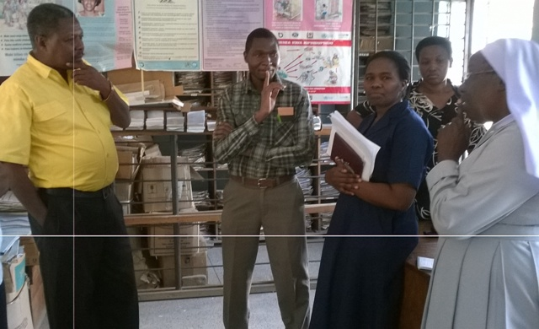
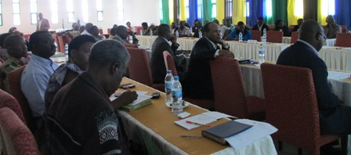
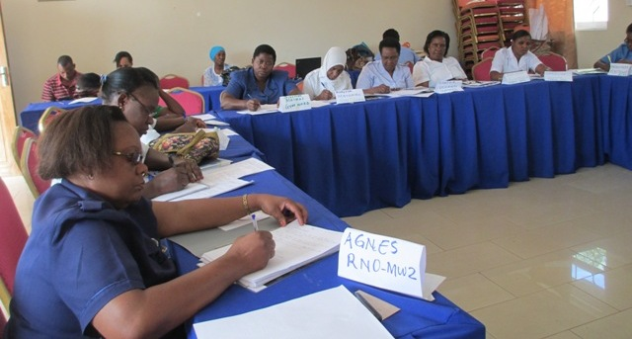
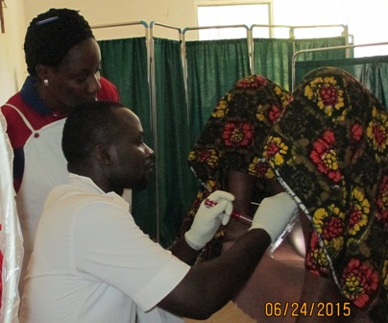
Approach
Phase I: Assess need and demand of cervical cancer services through review of health facility records at multiple entry points (RCH, Gyn, in Patient, Female ward, Maternity ward, STI ward and Care and Treatment Clinic)
Phase II: Site Readiness
Regional/District advocacy meetings
Facility assessment (HR capacity, equipment and supplies and management)
Procurement of medical equipment and supplies
6 days training on VIA/Cryotherapy skills in line with the Tanzania Service Delivery Guidelines for Cervical Cancer Prevention and Control

Slide 11
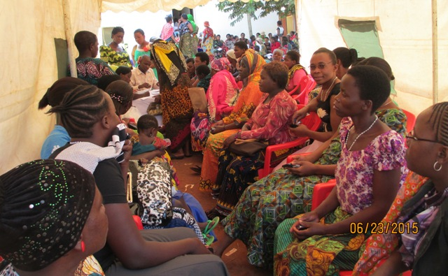
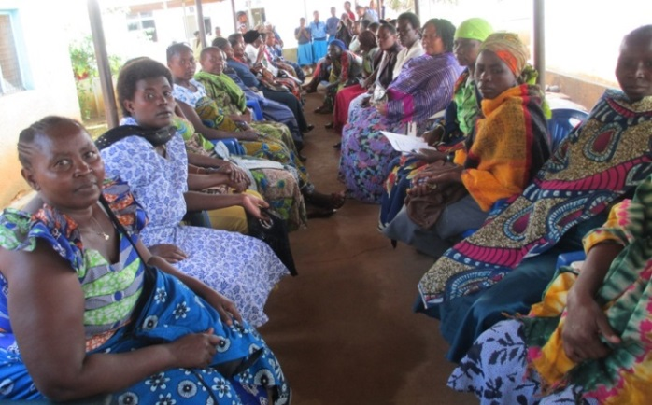
Approach
Phase III: Service Delivery
Integrated daily screenings at facility level (HIV, breast and cervical cancer screening)
Single Visit Approach (SVA)
Referrals for large lesions and suspicious cancers
Linking HIV+ women with care and treatment at same site
Offering prevention education to women found HIV-
Community mobilization for service uptake
Outreach screening services for hard to reach areas.
Provision of ongoing supportive supervision for mentorship and quality control

Slide 12
Summary of Screening Results (August 2011 – June 2015)
Total Screened | 23530
HIV+ | 7112 | 30% | Of Total Screened
HIV- | 16418 | 70% | Of Total Screened
VIA+ | 1402 | 6% | Of Total Screened
Suspicious Cervical Cancer | 406 | 1.7% | Of Total Screened
Breast Lumps | 238 | 1.0% | Of Total Screened
PITC | 16829 | 72% | Of Total Screened
PITC – HIV+ | 757 | 3.2% | Of Total Screened
Total Screened | 23530
VIA+ | 1402 | 6% | Of Total Screened
Total Cryotherapy | 1345 | 96% | Of Total VIA+
SVA | 1248 | 89% | SVA Rate

Slide 13
Results: Total Screened by Age Group
30%
26%
25%
14%
5%
On average, the program screens 450 women per month and to date over 23,530 women from ages 20 and up, and all HIV positive women irrespective of age were screened.

Slide 14
Results: Total VIA+ by Age Group
30%
23%
5%
Since program inception the average VIA positivity rate (regardless of HIV status) among 23,530 women is around 6%.

Slide 15
Results
86% of the women screened and with VIA positive results were treated on the same day and 14% referred for further management.
30% of the women screened were found HIV positive and were immediately linked to care and treatment
Cervical cancer and HIV/AIDS programs integrated at 3 health facilities
Over 100 health care workers (120 nurses, 40 clinicians) in Mara & Mwanza regions have been trained in the VIA/Cryotherapy procedure.
Facility systems strengthening:
Renovations conducted including installing water systems, AC units
Procurement of drugs and cryotherapy machines
Notes:
Talking Points:
Health care workers trained where from which departments – MCH, CTC, etc?
In one training, participants had an average pretest score of 49% and post test score of 81%.

Slide 16
Testimonials
“Thanks to IMA for bringing to us these services. Many women in our community have died of this deadly disease merely because there were no screening services.”
“Many women would like to check their health but have no bus fare from where they live. I had to travel for 50 km to access these services.”
“The CTC Nurse explained to us about the increased risk of getting cervical cancer when one is HIV positive. Since then, we (HIV+ clients) are motivating each us to get screened annually.”
“I have just been screened for HIV, cervical and breast cancers. Nurses are friendly, the test is simple and not painful. I feel very happy and free of these burdens.”
Notes:
Talking Point:
- These were gathered during client satisfaction interviews that IMA routinely conducted during the program

Slide 17
Lessons Learnt
High demand for cancer treatment services.
Cervical cancer is a major health concern among women.
The VIA and SVA are cheap alternatives to cytology-based screening programs in low resource settings. A bottle of Acetic Acid also known as Vinegar costs 3.5 USD and can run 90 tests and a gas tank of 25 kg costs 35 USD run between 20 – 25 tests.
A well designed and easy to follow training curriculum builds capacity of nurses and other non-physician health care workers to perform these procedures
Integration of cervical cancer interventions with HIV/AIDS programs adds more value to overall outcome of care
Multi stakeholder collaboration in planning, implementation and monitoring is key at national, regional and district levels
National Non-Communicable Disease Department (NCD-MoHSW),
Reproductive and Child Health Section (RCHS-MoHSW)
Ocean Road Cancer Institute (ORCI)
Christian Social Services Commission (CSSC),
Other implementing partners

Slide 18
Recommendations
Continue integration of cervical cancer interventions into HIV/AIDS programs for optimization of resource utilization and improved health outcomes.
Scale up of the HPV Vaccination program after evaluation of the Tanzania HPV vaccination pilot study.
Integration of CECAP into health care for women services to enable continuous program strengthening and sustainability.
Strengthen referral system for complicated cases through provision of LEEP machines and punch machines at all Regional Hospitals to increase client access to advanced services.
Notes:
Talking points:
- Studies have shown that the combination of HPV vaccination and cervical screening can provide the greatest protection against cervical cancer.

Slide 19
Recommendations
Review the national target of screening women between 30 – 50 years to expand to women below and above these age limits. Screenings have detected VIA positive and suspicious cancers in these clients who also are vulnerable to HIV/AIDS.
Continue advocacy to donors especially PEPFAR on the importance of integration of Cervical cancer programs into HIV programs
Understand better the integration of cervical cancer programs with PMTCT.
Continue breast cancer screening and integration with cervical cancer screening to improve health outcomes of women’s health.

Slide 20
THANK YOU FOR LISTENING! Asante Tatenda
Questions or Comments?

